Slide 1


AI Tools for Wildlife conservation with trainned eco guards.
Vysya College
Shabeena S
Saranya K M
Nisha S
TEAM CODE: S4F_CP_Team_39643

Slide 2
CONTENT
Abstract
Problem Statement
Objective
Data Collection and Preparation
Proposed Solution (Methodology)
Model Performance Evaluation
Github, colab link
Screenshots
Future Scope
Conclusion

Slide 3
Abstract
Abstract
As biodiversity continues to decline globally due to habitat loss, poaching, climate change, and human–wildlife conflict, there is an urgent need for scalable, accurate, and timely conservation methods.
This study proposes a framework integrating Artificial Intelligence (AI) tools with trained eco-guards (field rangers) to enhance wildlife protection and monitoring.
Key AI components include camera traps, drones, passive acoustic monitoring, computer vision models (e.g. CNNs, transformers), and predictive analytics to detect species presence, poaching threats, and changes in habitat health.

Slide 4
Problem Statements
Problem Statements
Challenges in Wildlife Conservation:
Habitat Loss, Fragmentation & Degradation
Human–Wildlife Conflict (HWC)
Poaching and Illegal Wildlife Trade
Insufficient Funding & Resources
Legal and Enforcement Weaknesses
Solution:
Use of Technology and Monitoring
Cost and resource constraints
Rapid Alert / Response Time:
Integration of Multi-Modal Data:

Slide 5
Objective
Objective
Enhance Wildlife Monitoring: Use AI for real-time tracking of animals and their movements.
Prevent Poaching & Illegal Activities: Detect intruders, weapons, and suspicious sounds quickly.
Improve Data Accuracy: Collect and analyze images, sounds, and location data with Ai.
Enable Predictive Analytics: Forecast poaching hotspots and animal migration patterns.
Assist Eco-guards with Technology: Provide AI-powered tools, apps, and real-time alerts for faster action.

Slide 6
Data collection and Preparation
Data set: Wildlife Conservation Data(5 years)
Year
Species
Region
Population
Habitat_area
Main threats
Protected_area
Conservation_status
Target: Human- Wildlife coexistence

Slide 7
Proposed Solution(Methodology))
Model used: CNN, YOLO, NLP, K means clustrring
1. Computer Vision (CNNs, Object Detection models like YOLO, Faster R-CNN) – for species identification in images and videos.
2. Acoustic AI Models (RNNs, CNNs, Transformers) – for detecting animal calls, gunshots, or chainsaws.
3. Remote Sensing + ML (Random Forest, SVM, Deep Learning) – for habitat mapping and land-use change detection.
4. Predictive Analytics (Time-series models, Bayesian networks, Reinforcement Learning) – for poaching risk forecasting and migration prediction.
5. Natural Language Processing (NLP) – for detecting illegal wildlife trade .

Slide 8
Model Performance Evaluation
Accuracy/F1 for classification,
RMSE/R² for regression,
FID/BLEU for generative models
Performance Analysis
Speed
robustness
fairness
resource efficiency
accuracy
precision

Slide 9
LINKS
Colab notebook link:
https://colab.research.google.com/drive/1Lb_5H5QNOazaLLdYPVb0NaiTMb-UKrWp?usp=sharing
Github link:
https://github.com/saranyakm46-sys/SSN-S4F_CP_Team_39643.git

Slide 10
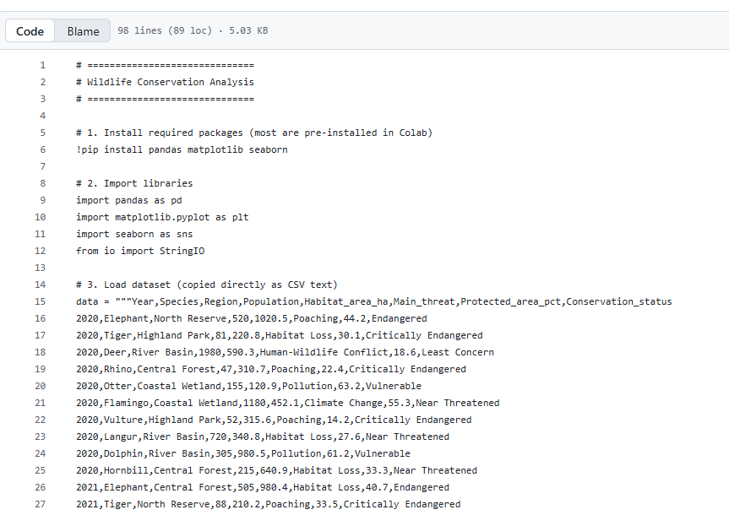
Screenshots:

Slide 11
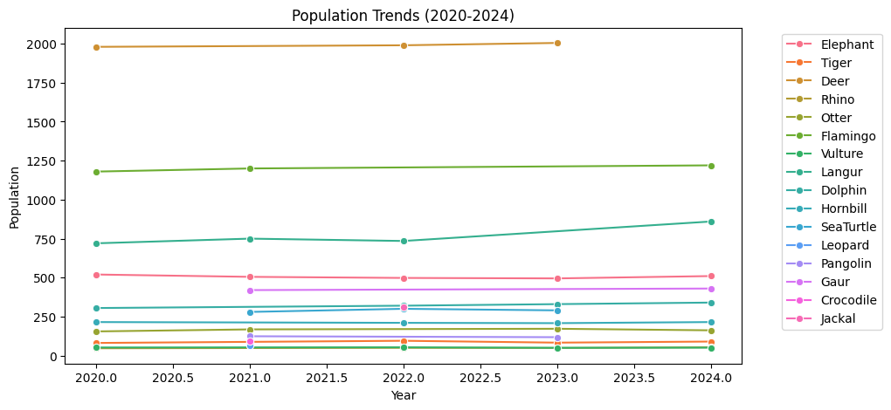

Slide 12
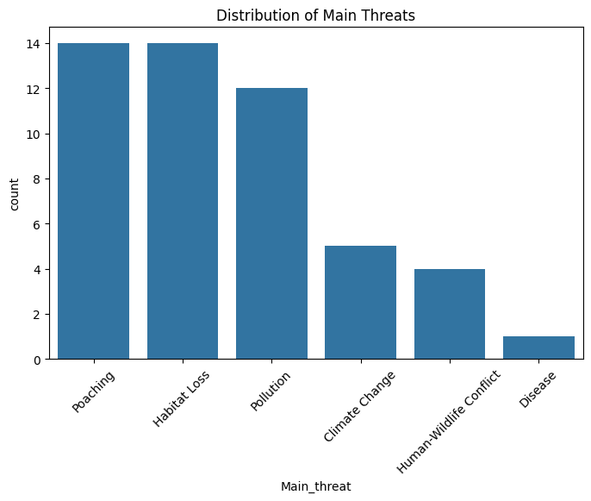

Slide 13
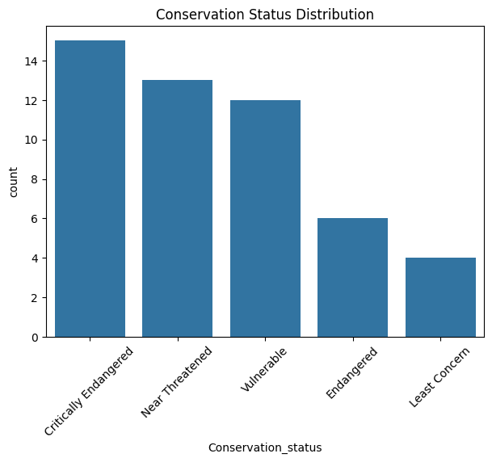

Slide 14
Future Scope
Enhancements:
Future enhancements for AI models focus on improving accuracy, scalability, interpretability, fairness, and robustness, while integrating efficient architectures, better training data, and continuous learning to adapt to evolving real-world needs.
If it’s about model precision: it measures how many of the animals detected/classified by AI are actually correct species (reducing false positives).

Slide 15
Conclusion
AI precision in wildlife plays a vital role in advancing conservation by ensuring accurate species identification, population tracking, and habitat monitoring.
By reducing errors and false detections, it allows researchers to make better decisions, allocate resources effectively, and respond quickly to threats like poaching or habitat loss.
With continued advancements in machine learning, drones, sensors, and big data analytics.
AI will further strengthen efforts to safeguard biodiversity, improve ecological research, and support sustainable coexistence between humans and wildlife.

Slide 16
Thank You
Notes:
Thank You !!

